Slide 1
DS 3000 Practicum 1
Brian Gerber, Dhruv Laungani, Matthew Tong, Wen Zheng
Notes:
Hello everyone, today we’ll be presenting our analysis of airline on-time performance as part of our DS3000 Practicum 1 project.

Slide 2
Question 1
The Data Science problem that we were given is analyzing flight delays for airlines departing from Arizona (AZ), Nevada (NV), and California (CA) in 2019. We want to analyze air traffic patterns and see which airlines are more likely to have delays. By looking at how often and how long flights are delayed, we hope to identify key factors that influence delays, which will provide information into airport congestion and potential solutions to the congestion.
Notes:
Script: The goal of this project was to analyze flight delays for airlines departing from Arizona, Nevada, and California in 2019. We aimed to understand air traffic patterns, identify airlines more prone to delays, and explore factors contributing to airport congestion and potential solutions

Slide 3
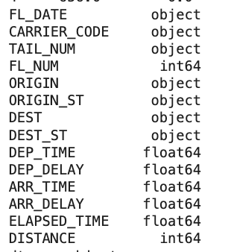
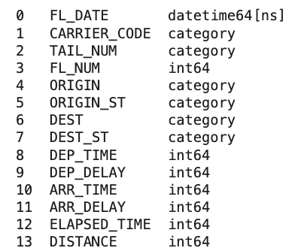
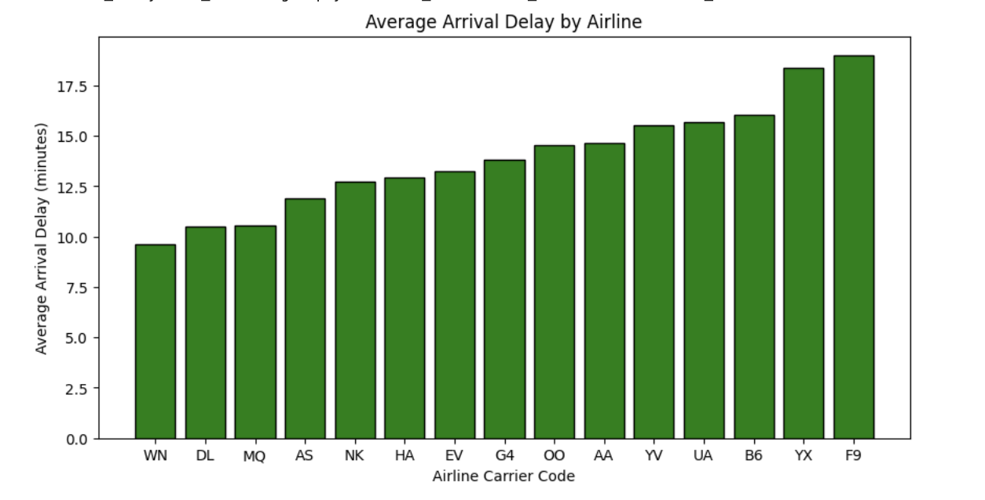
Question 2 - Preparing the Data
Approach:
Examine the data:
Missing values (max of 31884)
No invalid entries
Data dimension was 1,897,503 rows and 14 columns
Converted variables to suitable types
Dropped the rows with missing values
Only 1.75% of the data
Imputating with “0” could misrepresent actual delay
Chart: Average Arrival by Airline
Southwest Airlines(WN) have the lowest average arrival delay while Frontier Airlines (F9) have the longest average arrival delay
Notes:
Script: “To prepare the data, we started by examining the dataset for missing values, invalid entries, and overall structure. The dataset contained over 1.8 million rows and 14 columns, with a maximum of 31,884 missing values. We converted variables into suitable data types for analysis and dropped rows with missing values, which only accounted for 1.75% of the dataset. This decision was also made to avoid misrepresentation, as imputing with '0' could distort the actual delay times.
One initial analysis we looked into is the the average arrival delay by airline (graph on the left). Southwest Airlines (WN) had the lowest average arrival delay, while Frontier Airlines (F9) experienced the highest average delays.

Slide 4
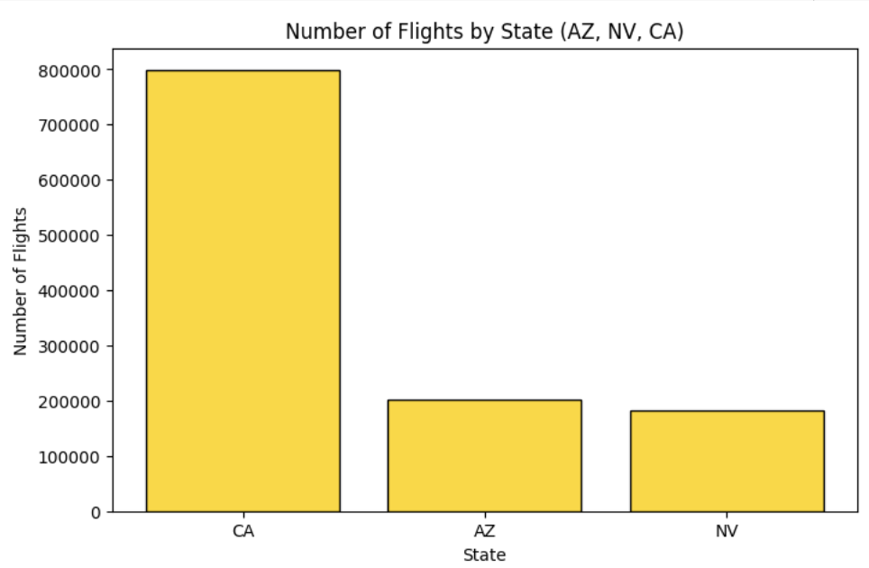
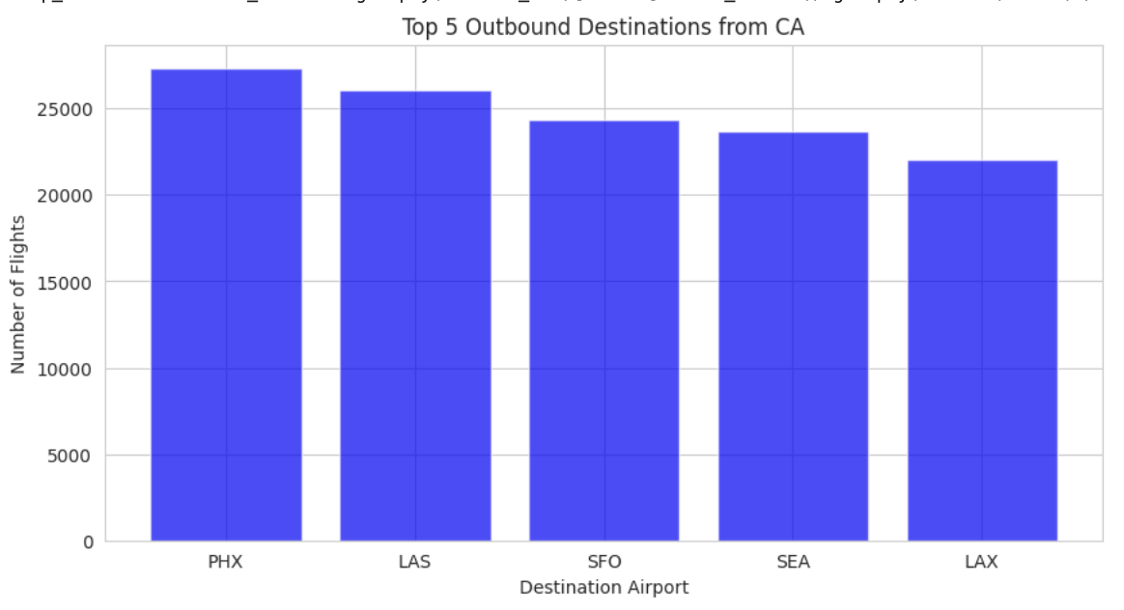
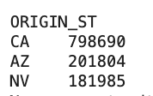
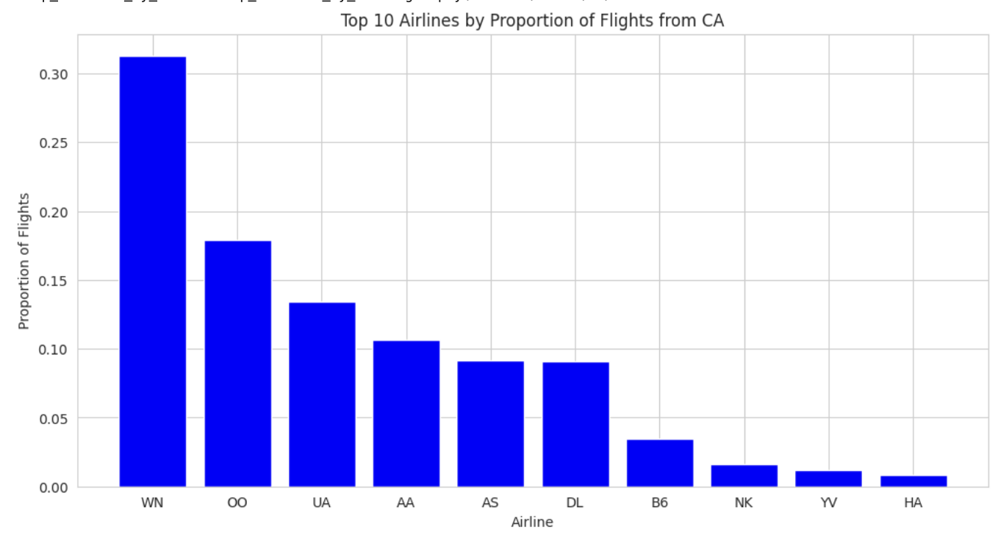
Question 3 - Most Air Traffic, Top 5 Outbound, Proportion of Flights
Approach for Identifying Most Air Traffic
Defined "most air traffic" as number of departing flights (ORIGIN_ST) rather than total flight time.
Focused on departure frequency due to its direct impact on airport congestion and delays.
Multiple short-haul flights create more congestion than fewer long-haul flights.
Chose departure states (ORIGIN_ST) over destination states (DEST_ST) to measure airport busyness, as delays and congestion originate at departure points.
Top 5 Outbound Destination (Key Insight)
California - the most popular destinations include Phoenix, Las Vegas, San Francisco, Seattle, and Los Angeles (within California or still in the Western part of the US)
Proportion of Flights from Each Airline/Operator, per Region (Key Insight)
Southwest Airlines (WN) dominates the airline market across California (CA), Arizona (AZ), and Nevada (NV)
California has more diversity in airline proportions (larger number of competing hubs and airlines operating within the state)
In Arizona, Southwest Airlines and American Airlines accounts for 60%
Notes:
Script: “Question 3 examines air traffic, top destinations, and airline proportions. 'Most air traffic' was defined as the number of departing flights, as frequent departures impact congestion more than total flight time. We focused on departure states since delays originate there. California leads with nearly 800,000 flights, followed by Arizona and Nevada. One key finding for top 5 outbound is key outbound destinations from California—like Phoenix, Las Vegas, and San Francisco are mostly short-haul within the western U.S. Looking at the proportion of flights by airline, Southwest Airlines dominates across all three states. California has a broader airline mix due to multiple hubs, but in Arizona, Southwest and American Airlines control over 60% of flights.”

Slide 5
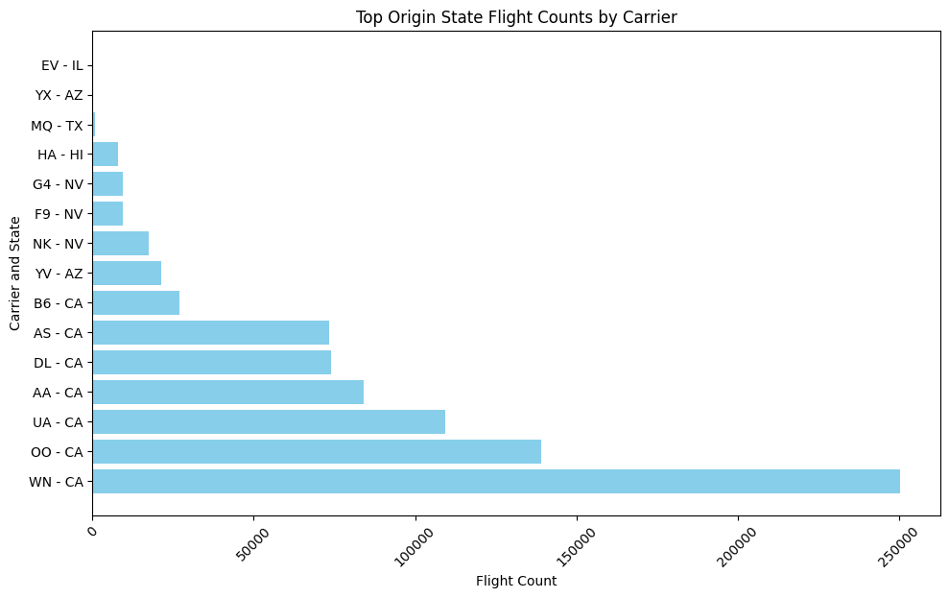
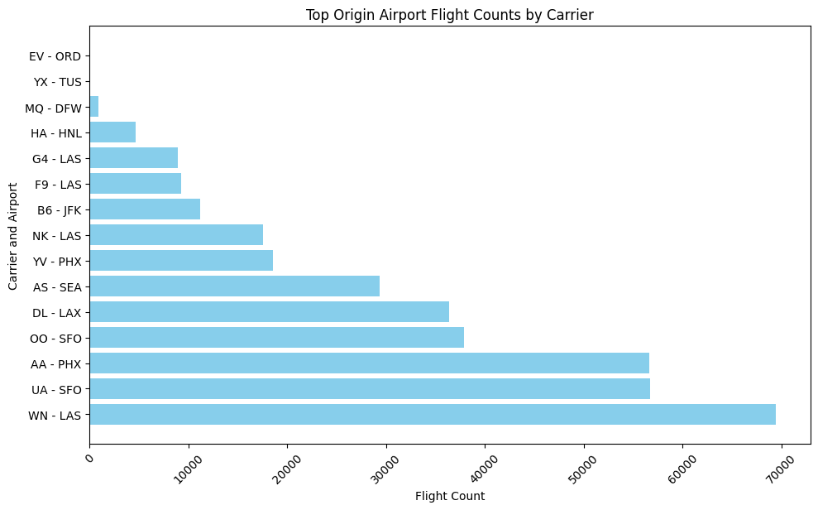
Question 4 Part 1
First interesting fact
Large west coast presence amongst top origin and top states in numbers of flights for each carrier
A state in the west coast is the most popular state for flights to depart from in 11 out of the 14 airlines
11 out of 14 airlines most popular airport is also in the west coast
Notes:
Left Graph shows top states with amount of flights and by carrier
Right graph shows top airport
An interesting fact from the data was the large presence of western regions
Over 75% of carriers had there most popular state in the west coast and more popular airport in the west coast
The graphs here highlight the top states and airports by flight volume for each carrier. The left graph shows the most popular states for flight departures by carrier, while the right graph highlights the busiest airports. One of the most interesting findings is the strong presence of the western U.S. in airline operations. Over 75% of carriers had their most popular departure state and busiest airport located on the West Coast, reinforcing the region’s dominance in air traffic

Slide 6
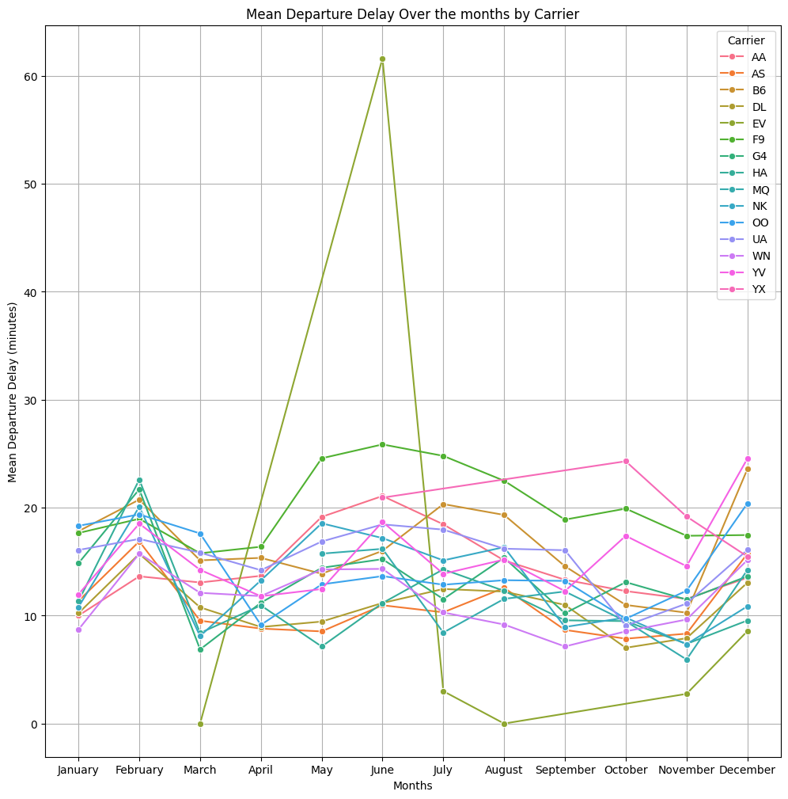
Question 4 Part 1
Second interesting fact
EV is a major outlier when it comes to average mean departure delay over the difference months during the months of may and june
After googling it appears that the company had strikes and many airplanes had to go in for repairs
The other airlines all follow a similar increase and decrease throughout the months showing that often weather and other factors cause the delays versus just the airlines
Some airlines means are still consistently lower than others
Notes:
To the right is a graph that graphs the mean departure delay per airline carrier over the months
Interesting to see that there are a couple outliers in the data including EV, YX and F9
Apart from that the variance amongst the rest of the data follows a very even curve
As one airline gets more delayed the rest do too
Many follow the exact same patterns as higlihghted in february, june, november and december
The graph on the right tracks the mean departure delay per airline carrier across different months. We observed a few major outliers, including EV, YX, and F9, which had significantly higher delays in certain months. Apart from these outliers, the rest of the airlines follow a relatively even curve. A key takeaway is that as one airline experiences more delays, others tend to follow the same pattern, likely due to broader factors such as seasonal congestion or weather disruptions. For example, the months of february, june, november and december followed the same patterns

Slide 7
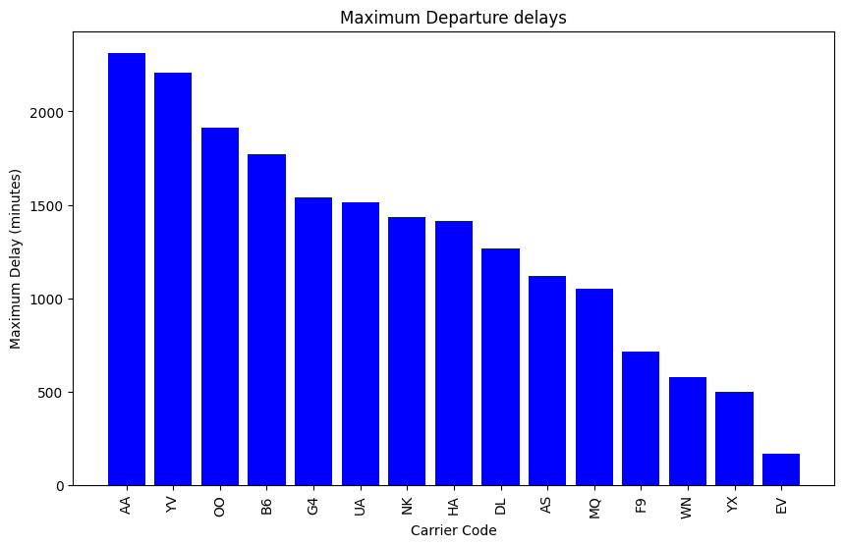
Question 4 Part 2
The minimums for each airline all came in at zero minutes
The maximums varied different with a lot having very high outliers. With every airline except one having a max delay at over 500 minutes
The two worst airlines American Airlines and YV both had delays over 2000 minutes
Overall these large outliers did not seem to skew the data very much
Notes:
Left is a graph of the single largest wait for a departure
The minimum was 0 minutes
There are some very large outliers with two airlines having over 2000 minutes
The graph on the left displays the single largest wait time for a departure per airline. While the minimum delay was 0 minutes, there were major outliers, with two airlines experiencing departure delays of over 2,000 minutes. This suggests that while most delays remain within a reasonable range, extreme cases can significantly impact passengers

Slide 8
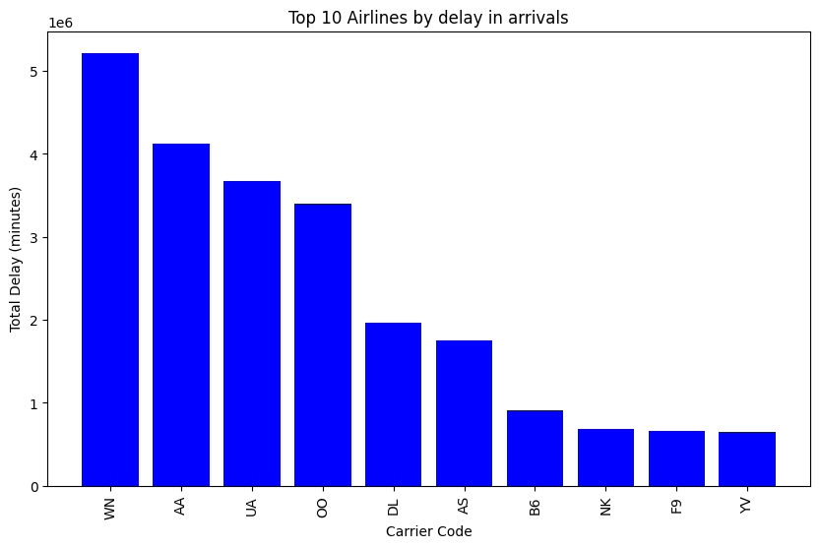
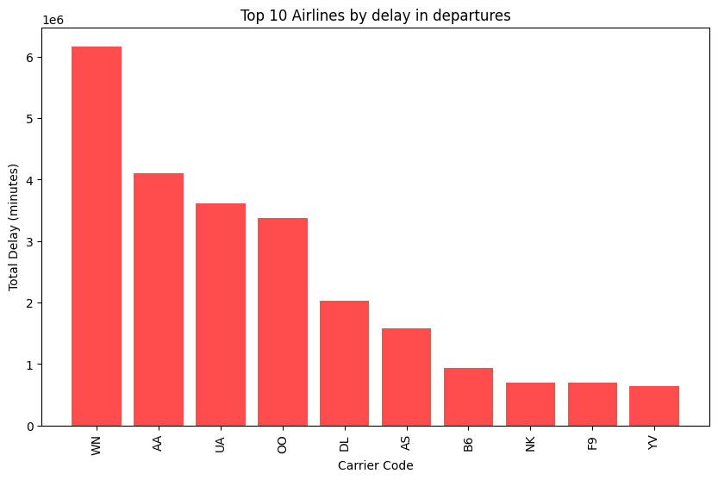
Question 4 part 2
Most total delay time
Most total delay time
The airline that by far had the most total delay time was WN or southwest airlines, with American and United coming in distant second and third
This does not tell us much as Southwest flies a lot more flights than any other airline
Notes:
Total summation of airlines delay in arrivals/departures in minutes
This is more of a numbers game where Southwest is be far in first as it had the most flights
Does not tell us much about the data as Southwest performs very well in the mean and standard deviation tests
This graph represents the total delay time in minutes across all airlines, including both arrival and departure delays. Since Southwest Airlines (WN) operates the most flights, it has the highest cumulative delay time by far. However, this metric alone doesn’t tell us much about airline performance because Southwest actually performs well in both average delay and standard deviation tests. This highlights why looking at total delay time in isolation can be misleading

Slide 9
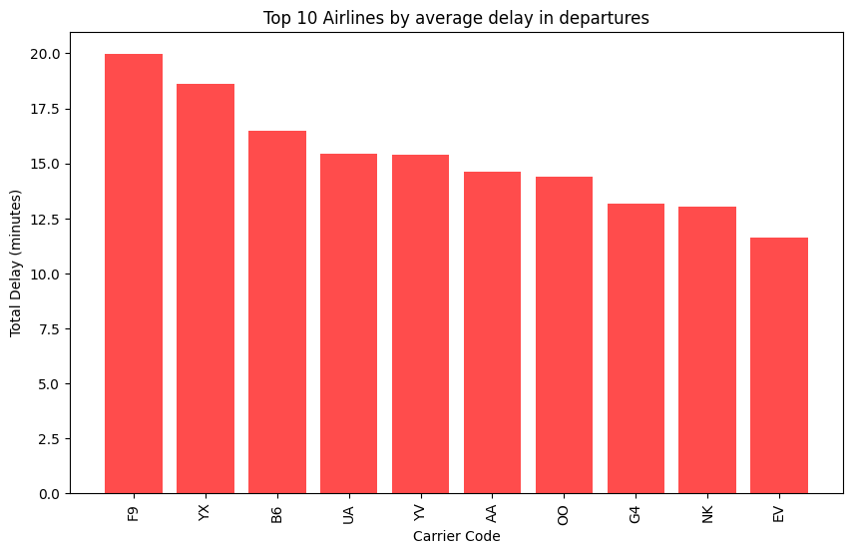
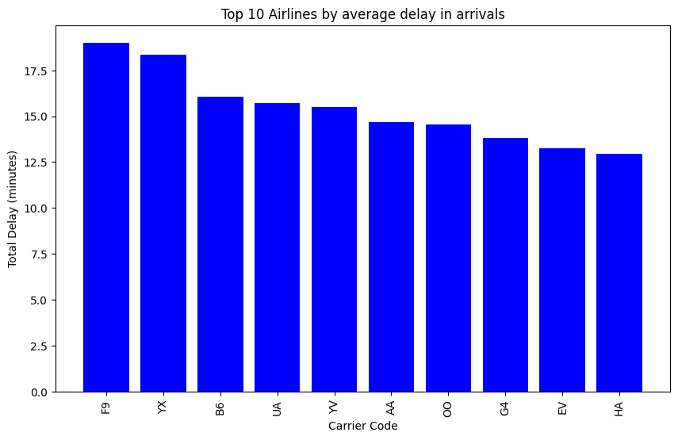
Question 4 part 2
Average delay
Different from previous graphs the airline that now performs worst is F9 and YX
Neither airlines were high on the list of total delay time
Southwest airlines is now not even in the top 10 even though it had the most total delay time
United Airlines, American Airlines, and YV are all similar
This tells us that F9 and YX on average are going to have a delay of over 17 minutes
Notes:
mean/average delay
Red graph is for departures
Blue graph is for arrivals
Now we see a very different graph
Focus on F9 and YX both having 2 more minutes of average delays than any other airlines
Also Southwest is no where to be seen shows total time is not the best method
This graph shifts the focus from total delay time to mean/average delay per flight. The red bars represent departure delays, while the blue bars represent arrival delays. Here, we see a very different ranking of airlines. Frontier (F9) and Republic Airways (YX) stand out with delays over 2 minutes longer than any other airline. Interestingly, Southwest is no longer on this list, reinforcing the idea that total delay time isn’t the best metric to evaluate airline performance.

Slide 10
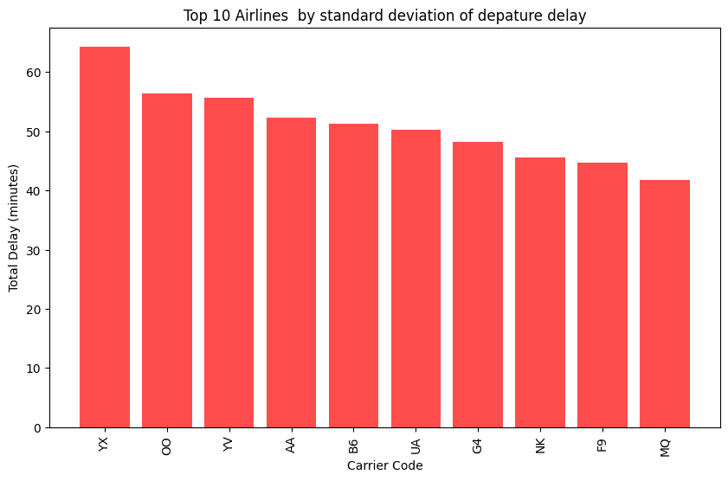
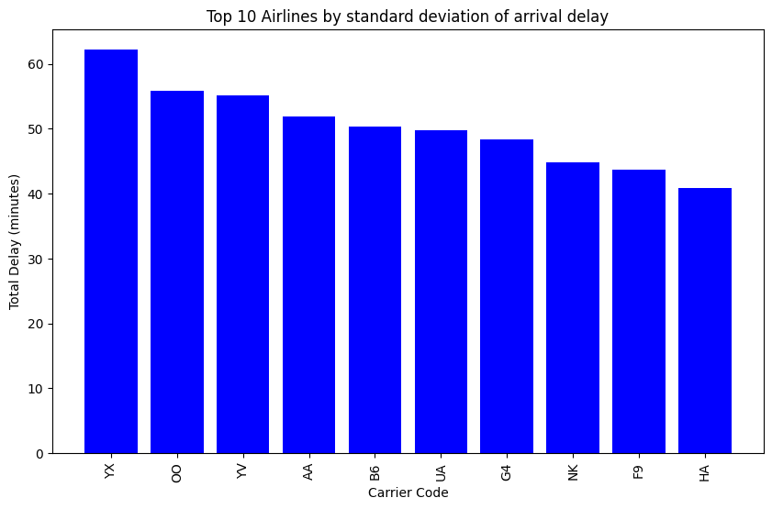
Question 4 part 2
Delay StDev
F9 has a lower standard deviation than YX Possibly the worst airline in terms of consistency having a deviation over 60 minute also ranking second worst in average delay in departures/arrivals
Takeaways
YX and Frontier are the two worst airlines in terms of consistency and average delays.
These have high delays but also a high amount of variance which can add stress for possible passengers.
Many airlines with a large amount of flights have a large amount of total delay time, but on average per flight is actually not too terrible
Notes:
This is the standard deviation
Consistency is very important and lower consistency is better
This is why YX ranks as the worst airline as its variance is by far in first place with over 10 minutes more of variance than any other airline
It also was second in terms of longest delays
This graph focuses on delay consistency, where lower standard deviation is preferred because it means fewer unpredictable delays. YX ranks as the worst airline, with a variance more than 10 minutes higher than any other airline. It was also the second worst in terms of average delays, making it one of the least reliable airlines in our analysis. This highlights that consistency is just as important as the total delay itself, as passengers value predictability in flight schedules.

Slide 11
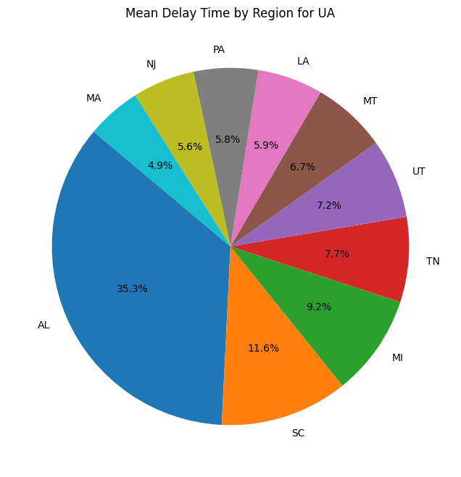
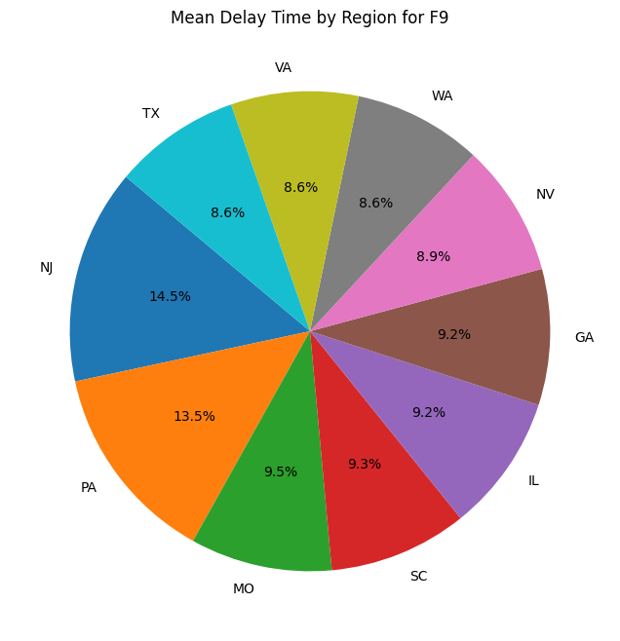
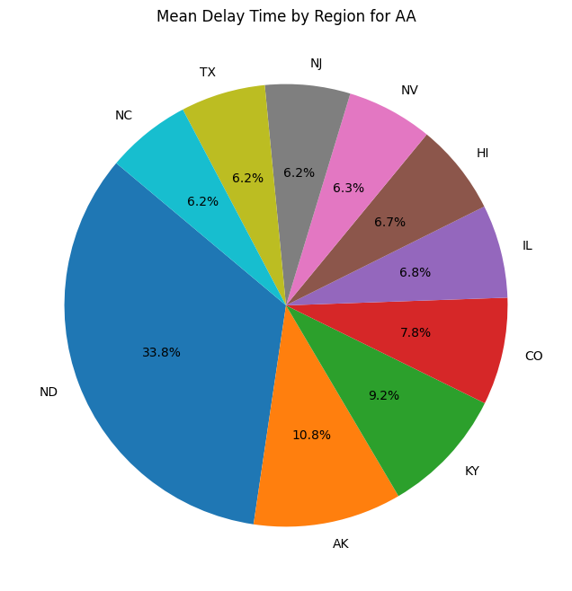
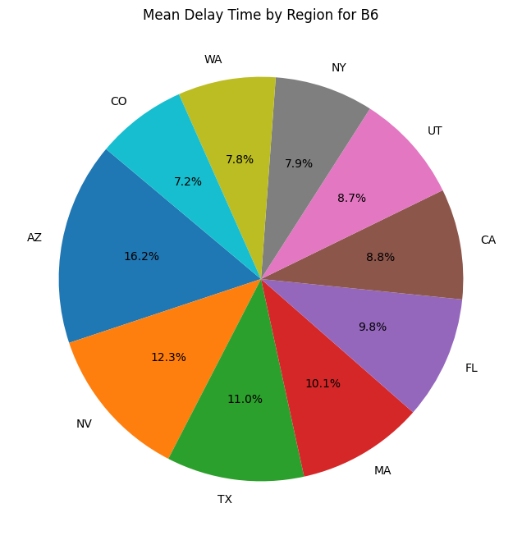
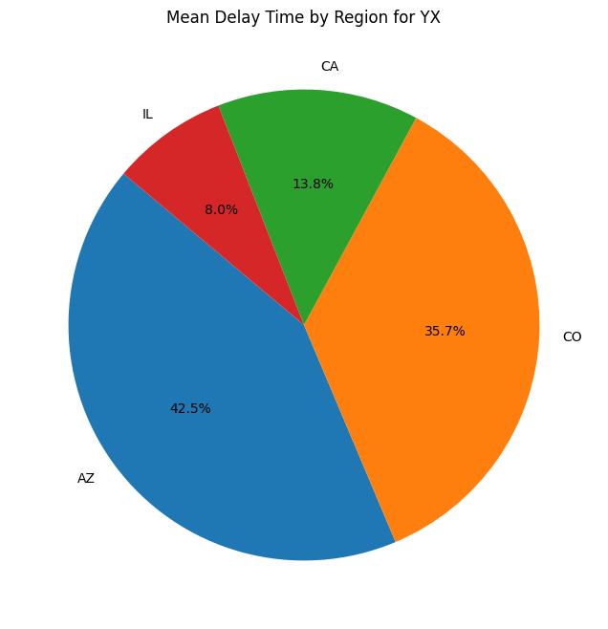
Question 4 part 2
Regional Delays
Notes:
These pie charts represent five airlines that performed the worst in both standard deviation and mean delay tests
American airlines
Jet Blue
United Airlines
Frontier
Republic airways

Slide 12
Question 4 part 2
Analyzing pie charts
The 5 airlines chosen were the five worst airlines in terms of standard deviation and average delays
The data does not contain one state that ranks highly on each of the airlines
However 60% of the airlines have 1 or two states that are large outliers in terms of total delay time
American Airlines -Worst state by far is North Dakota making roughly 33% of delays on average
United Airlines -Worst state by far is Alabama making roughly 35%
YX -Has two worst states with Arizona and Colorado both making up over 70%
Notes:
3 of the 5 airlines that performed poorly had one or two states that caused a large proportion of their delays in terms of the mean
American was north dakota
United was alabama
And YX has arizona and colorado
Another key takeaway is that some airlines experience disproportionate delays in certain states. Three of the five worst-performing airlines had one or two states that accounted for a large share of their delays:
American Airlines (AA) → North Dakota
United Airlines (UA) → Alabama
Republic Airways (YX) → Arizona & Colorado

Slide 13
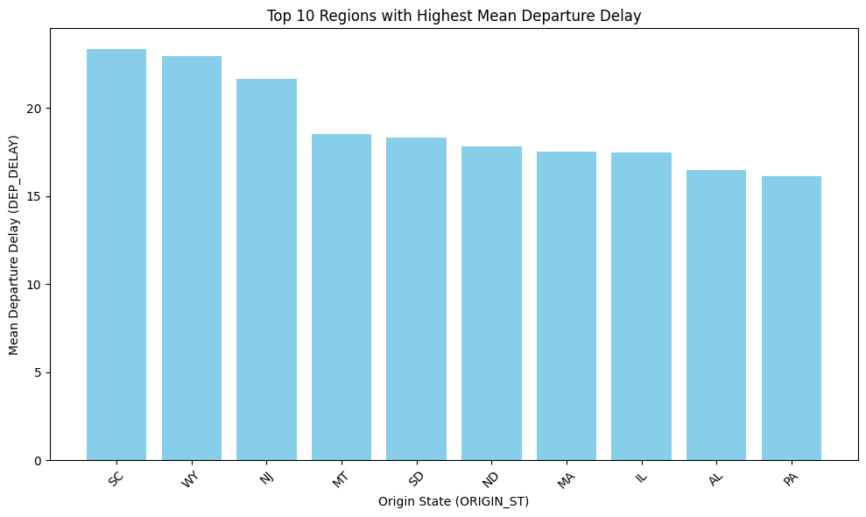
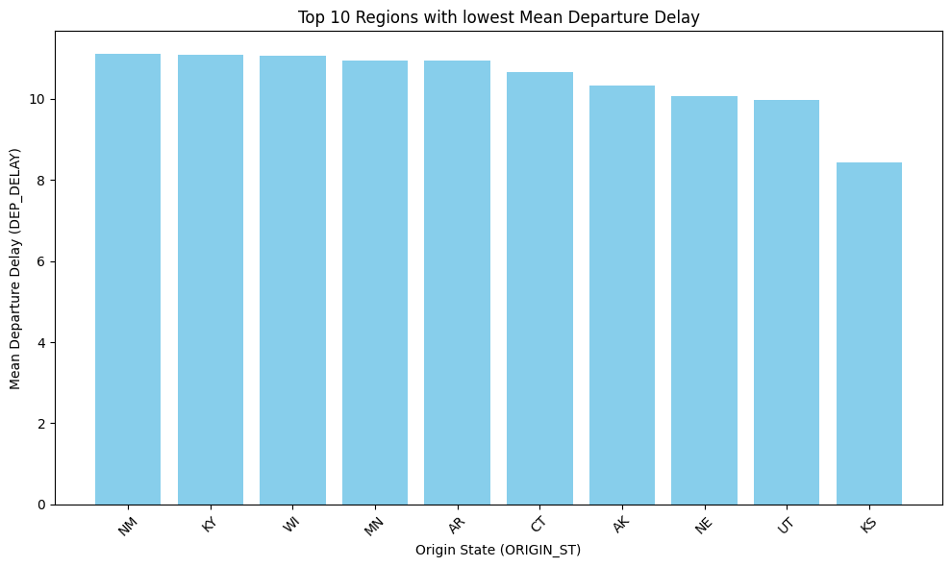
Question 4 part 2
Worst states
These two bar plots show the top 10 best and worst states in terms of their mean for departure times
The difference between the max and minimum is 13 minutes.
The average is also 13.8 minute, with 75% of the states having less than 16 minutes of delay
Many of the worst states are states that have more severe weather pointing that being the issue rather than the airlines themself
Notes:
Best and worst states based on mean departure delay
Had more variance than I would of thought
Many worse states have more sevre weather which could be part of the reason
The difference between the maximum and minimum was 13 minutes
Wyoming south carolina, and new jersey all had an average of over 20 minutes of departure delay which shows those are not great states to catch flights in
This slide ranks the best and worst states based on mean departure delay. A few key observations:
More variance than expected—departure delays were not evenly distributed across states.
Weather may play a role, as many of the worst-performing states experience more severe weather.
The difference between the best and worst states was 13 minutes, which is significant for frequent travelers.
Wyoming (WY), South Carolina (SC), and New Jersey (NJ) had average delays exceeding 20 minutes, making them some of the least reliable states for departures

Slide 14
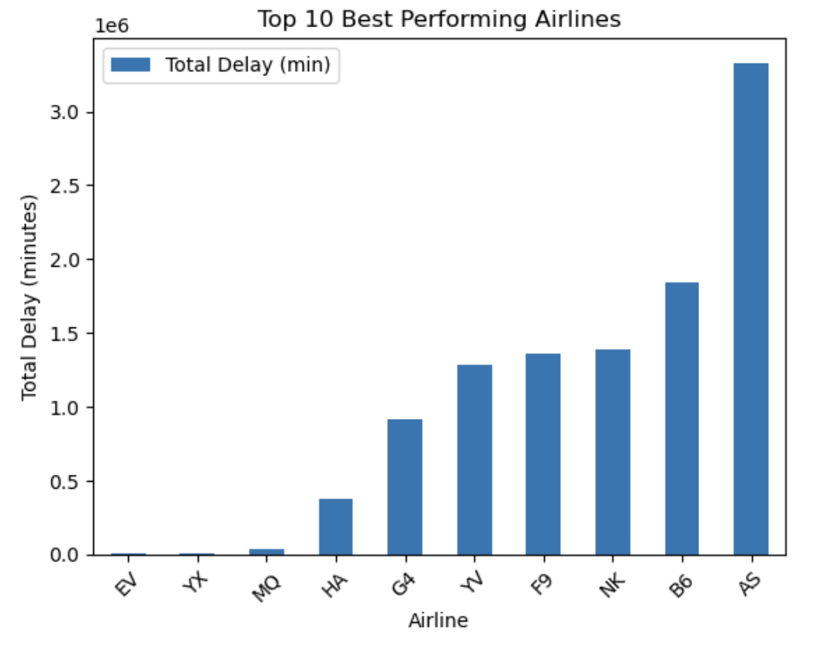
Question 5(Part 1)
Approach: To calculate best performance, we found the “total delay”, which is the sum of DEP_DELAY + ARR_DELAY. A “total delay” represents a better performing airline.
Implementation: Calculate the total delay for all flights, then use that to find the total delay for all airlines. Then, find the lowest 10 airlines based on total delay.
Discovery: We found that EV, YX, and MQ were the best performing airlines whereas AS was the 10th best performing airline. EV, YX, and MQ had almost 0 minutes of delay whereas AS had a little over 3 minutes in delay.
Notes:
Script: For question 5, it asked to find the 10 best performing airlines. Our approach for this was to add the departure delay and arrival delay times together to get a total delay. The lower the delay, the better a performance was for an airline, so the lowest 10 were the 10 best performing. Based on this approach, we found that airlines like EV, YX, and MQ were the best performing because they had little to no delay at all. Even the highest on the chart only had about 3.5 minutes of delay.

Slide 15
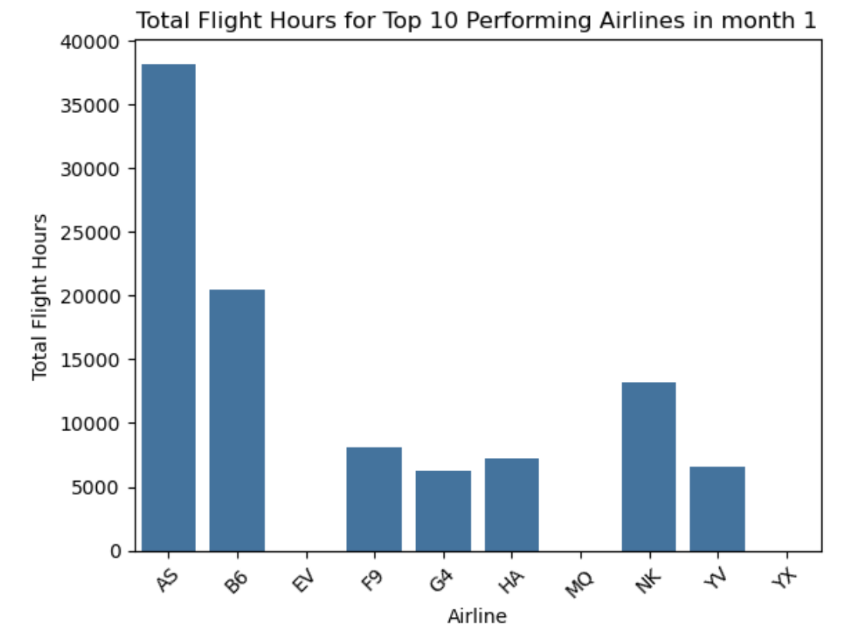
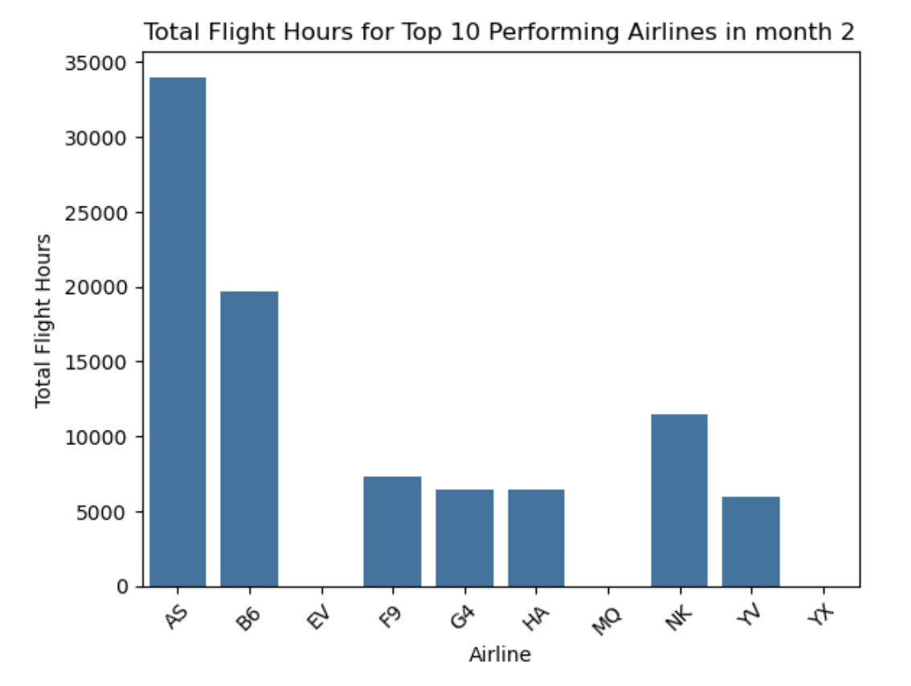
Question 5(Part 2)
Approach: We sorted the dataset by airline, month, and total flight hours. Then, only get the total flight hours for the 10 best performing airlines. Now that we have the flight hours for the top 10, we get all the unique months and create a chart for each month representing all the airlines.
Discovery: Overall, the top 10 airlines showed little fluctuation throughout the 12 months. However, I noticed that most had low total flight hours, leading to fewer delays, unlike larger airlines. A bigger airline would experience more delays because of more flights overall. The exceptions include AS, B6, and NK, as no other airline exceeded 10,000 flight hours per month.
Notes:
Script: For part 2, our approach to show the total flight hours for the top performing airlines by month was to get the total flight hours for all airlines and sort by month and airline. By doing this, we were able to only get the airlines that were in the top 10 from part 1. We found that the top 10 airlines fluctuated very little over the 12 months. In addition, most airlines had low total flight hours each month, which makes sense because that would mean less chance of delay. Other than airlines AS, B6, and NK, no other airline in the top 10 exceeded 10,000 flight hours per month.

Slide 16
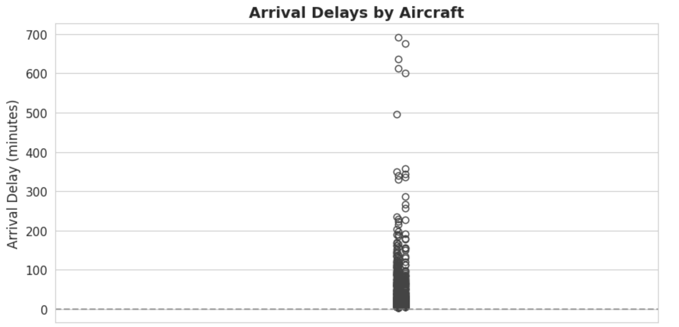
Question 6(Part 1)
Arrival Delays plot
Approach: Analyzed arrival delay patterns for three specific aircraft (N726SK, N728SK, and N742SK) using boxplot visualization to show delay distribution.
Implementation: Created boxplots showing median, quartiles, and outliers of arrival delays for each aircraft.
Discovery: All three aircraft showed similar arrival delay patterns with medians around 0-15 minutes and occasional extreme outliers reaching up to 700 minutes.
Notes:
In this plot, we analyzed arrival delay patterns for three aircraft: N726SK, N728SK, and N742SK. Using boxplots, we visualized the median, quartiles, and outliers for each aircraft. The results show similar delay patterns across all three, with medians ranging from 0 to 15 minutes. However, we observed occasional extreme outliers, with delays reaching up to 700 minutes, highlighting the importance of addressing operational inconsistencies.

Slide 17
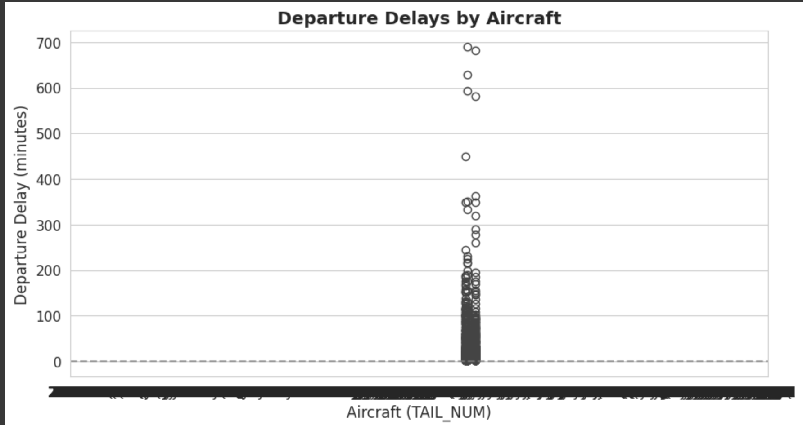
Question 6 (Part 2)
Departure Delays plot
Approach: Examined departure delay distributions for the same three aircraft using boxplot visualization.
Implementation: Generated boxplots displaying the spread of departure delays, including median values and outliers.
Discovery: Departure delays followed similar patterns to arrival delays, with most delays clustering in the lower range but showing significant outliers.
Notes:
Here, we examined departure delay patterns for the same three aircraft, again using boxplots to highlight the data distribution. Departure delays mirrored the trends seen in arrival delays—most delays clustered in the lower range, around 0 to 15 minutes. However, we also observed significant outliers.

Slide 18
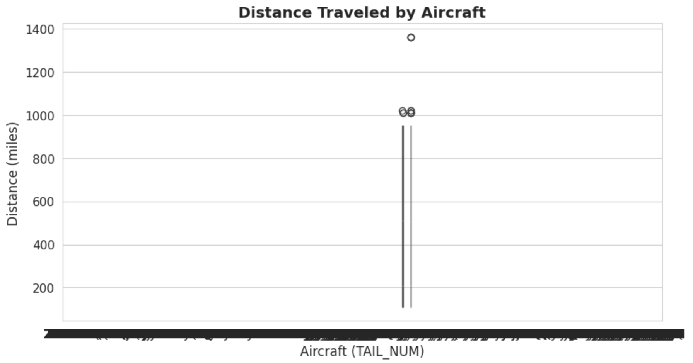
Question 6 (Part 3)
Distance Traveled plot
Approach: Investigated flight distance patterns for each aircraft to understand their typical route lengths.
Implementation: Created boxplots showing the distribution of flight distances for each aircraft.
Discovery: All three aircraft operated consistently within similar distance ranges, typically around 1000 miles, indicating they primarily serve regional routes.
Notes:
This slide investigates the flight distances for the three aircraft to understand their typical routes. The boxplots reveal that these aircraft primarily operate within similar distance ranges, typically around 1,000 miles. This suggests they are likely serving regional routes, which may also explain the consistent delay patterns seen earlier

Slide 19
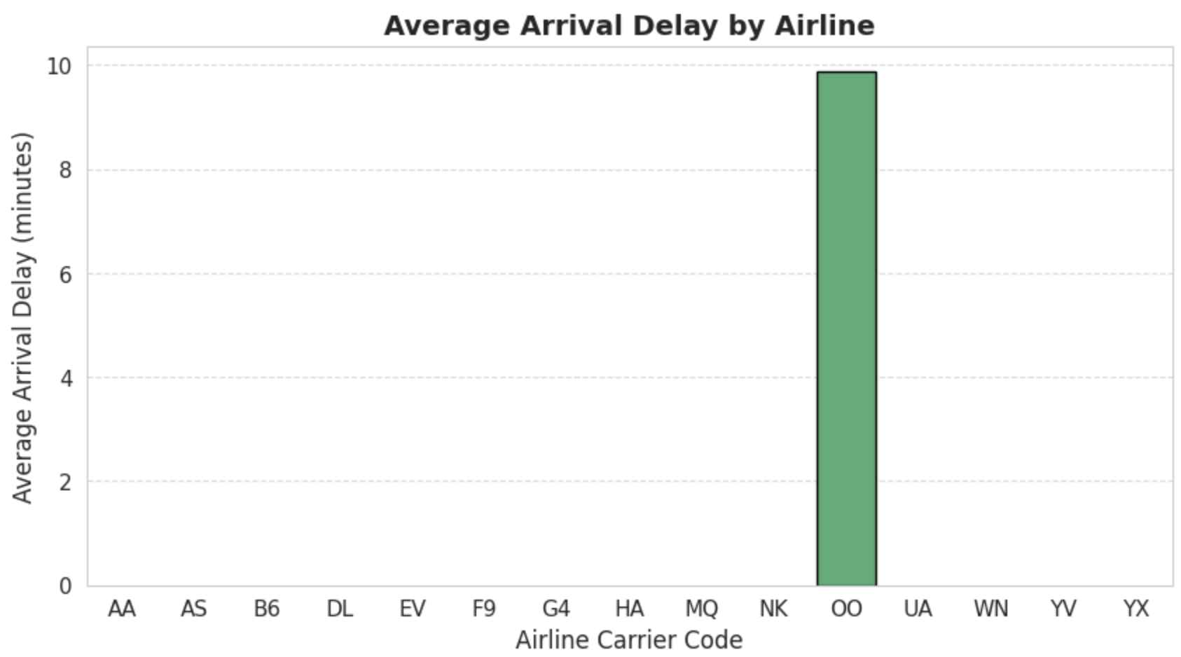
Question 6 (Part 4)
Average Arrival Delay by Airline
Approach: Analyzed average arrival delays grouped by carrier code to compare airline performance.
Implementation: Generated a bar chart showing average arrival delays for each carrier.
Discovery: SkyWest Airlines (OO) showed consistent performance across all three aircraft in their fleet.
Notes:
Lastly, we analyzed the average arrival delays grouped by carrier code to compare airline performance. This bar chart shows that SkyWest Airlines (OO) consistently outperformed others in terms of minimizing delays across all three aircraft, showcasing effective operations and a well-managed fleet

Slide 20
Question 7 - Summary of Key Findings
Worst-performing airlines: Frontier (F9) and Republic Airways (YX) had the most severe delays, with F9 averaging 20-minute departure delays and high inconsistency, pointing to potential operational inefficiencies like scheduling or capacity issues.
Regions with highest/lowest delays: South Carolina (SC), Wyoming (WY), and New Jersey (NJ) had the highest average delays (20+ minutes), while New Hampshire (NH) and Kansas (KS) consistently had the lowest delays (under 10 minutes).
Best-performing airlines: EV and HA had the lowest total delays, with smaller carriers like EV outperforming larger airlines like AS and B6, possibly due to greater operational flexibility and fewer scalability challenges.
Notes:
Script: To summarize some main key findings: Frontier (F9) and Republic Airways (YX) had the most severe delays, with F9 averaging 20 minutes and showing inconsistent performance, likely due to operational inefficiencies. Regionally, South Carolina, Wyoming, and New Jersey had the highest average delays, exceeding 20 minutes, while New Hampshire and Kansas consistently had the lowest, under 10 minutes. Finally, airlines like EV and HA ranked as the best performers with the lowest total delays. Smaller carriers like EV outperformed larger airlines like AS and B6, likely due to greater operational flexibility and fewer scalability challenges

